Slide 1

HOSTEL MANAGEMENT SYSTEM
Presented By
27003 Yash Bhoge
27010 Vedant Deokar
27018 Pritesh Gadiya
27076 Darshan Taskar

Slide 2
Problem Statement
To design the Hostel Management System for automating the activities of hostel and to help the user to manage the records in systematic manner and to reduce the risk of file lost and save time while searching/ inserting/ deleting or updating a record manually.

Slide 3
Objective
To automate the process of manually maintaining the records
Helps to maintain day to day records in computer
To make it easier to maintain the record of large number of students in hostel
To save the time and increase efficiency
Provide faster access to data

Slide 4
Scope of Mini-Project
Helps to manage the records in systematic manner
Managers can maintain a lot of data such as number of students can accommodate, hostel in and out of student, guest and visitor record.
Helps to save the data for longer period of time and reduces the risk of data loss.
Accuracy in calculations
Easy user interface

Slide 5
Modules
Resident
Room allocation
Local Guardian
Complaints
Fees details
Organization

Slide 6
Hardware and Software Requirements
Hardware Requirement
Intel core i5 10th gen processor
Software Requirement
Content | Description
Operating System | Windows 7 or above
Database | SQL server
IDE | Visual Studio Code

Slide 7
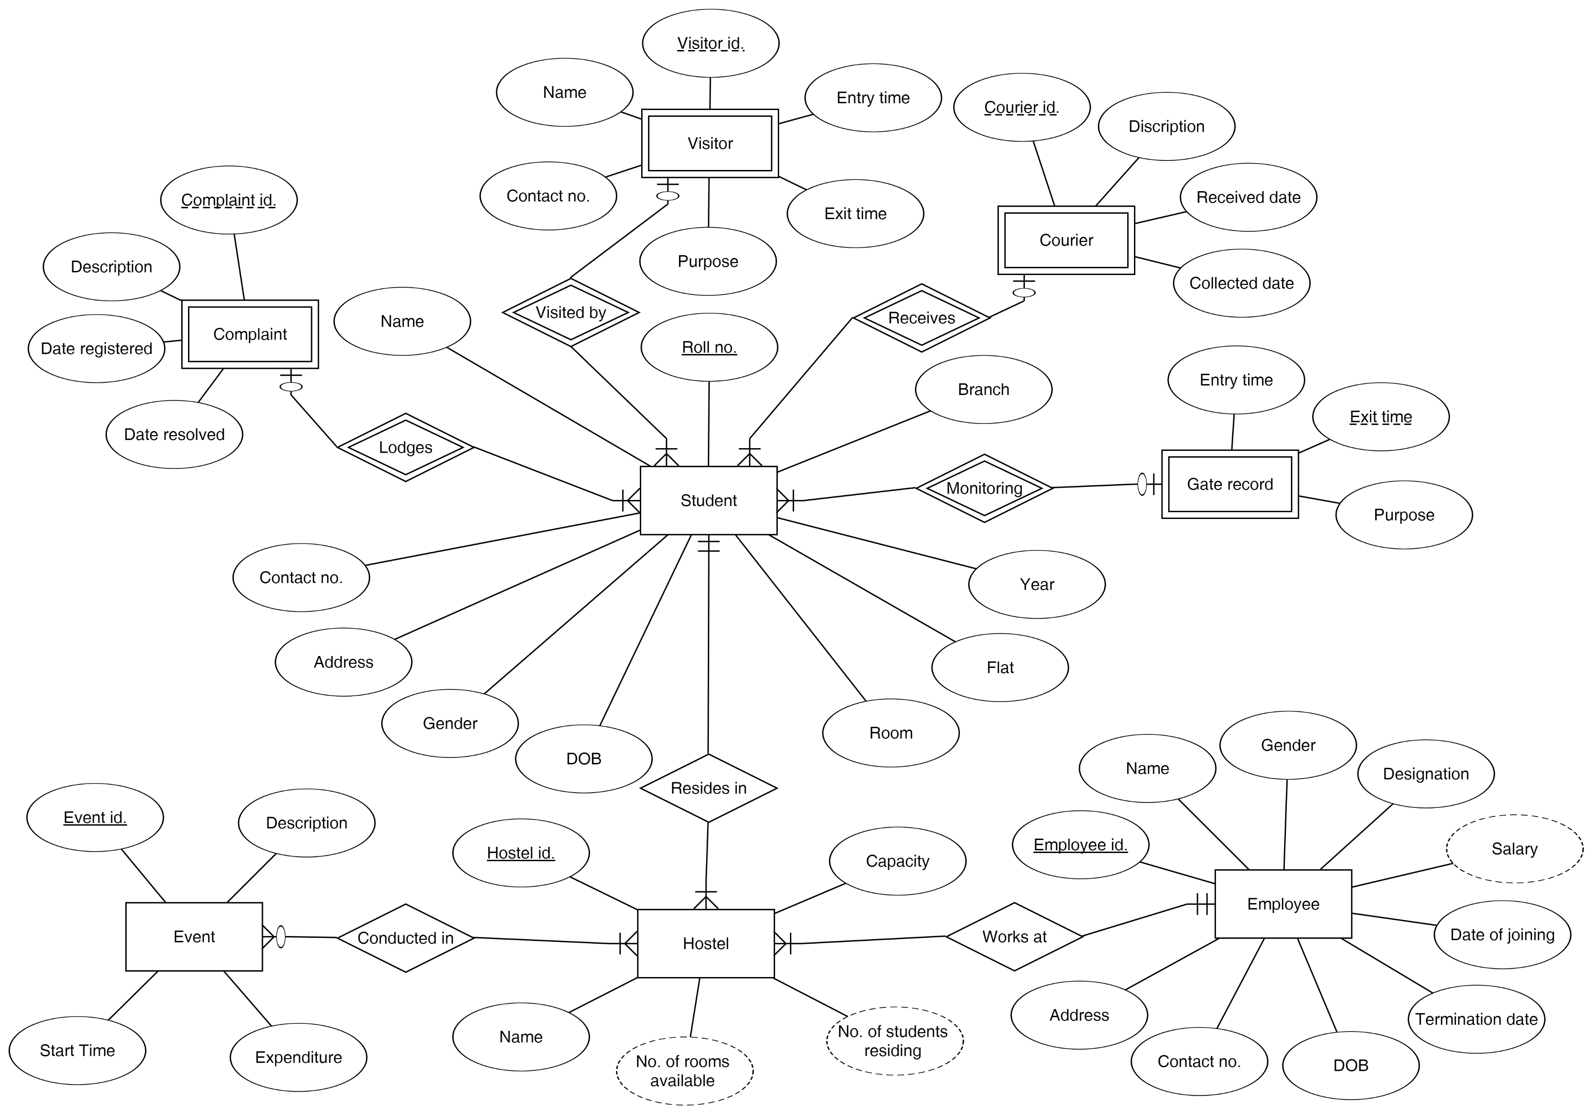
ER Diagram

Slide 8
Schema Diagram

Slide 9
References
1. www.w3schools.com
2. in.php.net
3. en.wikipedia.org/wiki/PHP
4. www.hotscripts.com/category/php/
5. www.apache.org/ 6. www.mysql.com/click.php?e=35050

